Slide 1
Milestone One
Nick Abcarius
Andrew Do
Travis Garcia
Nicole Pavlovich
Steven Tan
Notes:
nicole

Slide 2
Milestone Goals
Create a table and store it in a columnar format
Design a lineage-based updating solution
Implement the select, insert, update, delete, and sum queries
Notes:
nicole

Slide 3
Overview

Slide 4
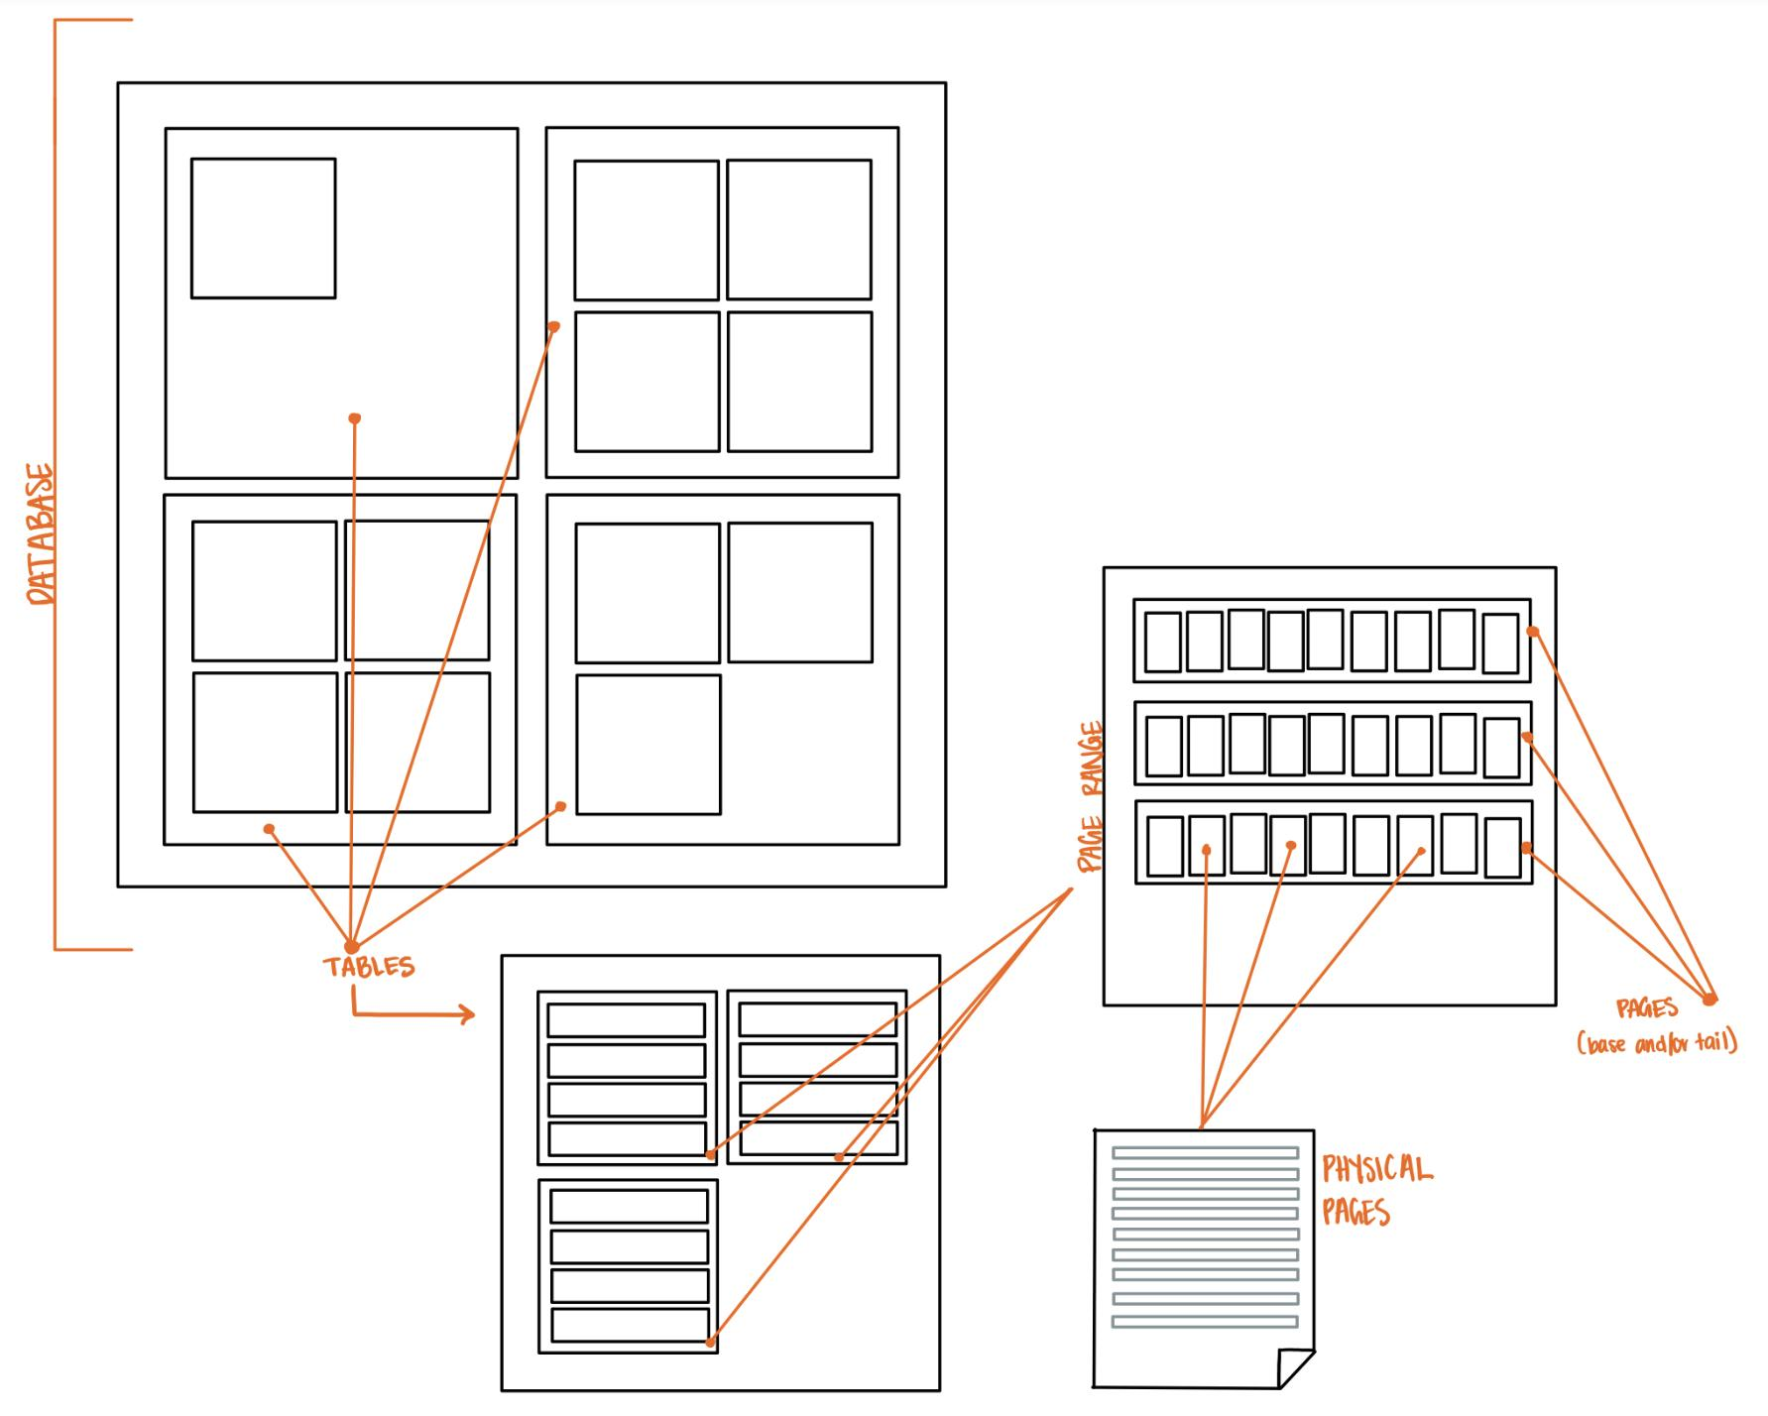
class Database():
def __init__(self):
self.tables = []
def create_table(self, name, num_columns, key)
def drop_table(self, name)
def get_table(self, name)
Notes:
travis

Slide 5
Layered Design
Table.py | Maps keys to RIDs, sends queries to correct page range, and then calls PageRange.py query functions
PageRange.py | Determines page and physical location for a given query and uses Page.py functions to properly set up records across pages and perform operations on them
Page.py | Keeps track of physical pages and calls the PhysicalPage.py functions that append, read, or update data
PhysicalPage.py | Stores data in a byte array and provides logic to append, read, and update data
Notes:
Cumulative Update
Direct physical RID mapping
Page_directory currently only used to store page ranges
Notes:
travis

Slide 6
Design Breakdown

Slide 7
Query object performs queries on the data
Failed queries return false
Each layer of our design handles different aspects of a query
class Query:
def __init__(self, table):
self.table = table
def delete(self, key)
def insert(self, *columns)
def select(self, key, column, query_columns)
def update(self, key, *columns)
def sum(self, start_range, end_range, aggregate_column_index)
def increment(self, key, column)
What the User thinks of:
 | Data A | Data B | Data C
1 | x | x | x
2 | x | x | x
3 | x | x | x
Notes:
nick

Slide 8
self.name, self.key
class Table:
def __init__(self, name, num_columns, key):
self.name = name
self.key = key
self.num_columns = num_columns
self.page_directory = [PageRange()]
self.keyToRID = {}
self.baseRID = -1
self.index = Index(self)
def insert(self, record)
def update(self, key, record)
def select(self, key, column, query_columns)
def delete(self, key)
def sum(self, start_range, end_range, aggregate_column_index)
def getPageRange(self, baseRID)
Entry | Column 1 | Column 2 | Column 3
1 | x | x | x
2 | x | x | x
3 | x | x | x
|________________________|
4 columns
Notes:
Sends queries to correct page range and then calls PageRange.py query functions
nicole

Slide 9
Column Breakdown
Indirection: Base indirection points to most updated tail RID. Tail indirections point to previously updated RID
RID: Unique identifier for base and tail records which physically maps to their page locations
Timestamp: Time of last edit/creation
Schema: A single 0 or 1 for our cumulative update which indicates if a record was updated or not
Key: Provided on insert and mapped to a record base RID
Indirection | RID | TimeStamp | Schema Encoding | columns[0] (key) | columns[1] | ...
class Record:
def ____init__(self, rid, key, columns):
self.rid = rid
self.key = key
self.columns = columns
Notes:
nicole

Slide 10
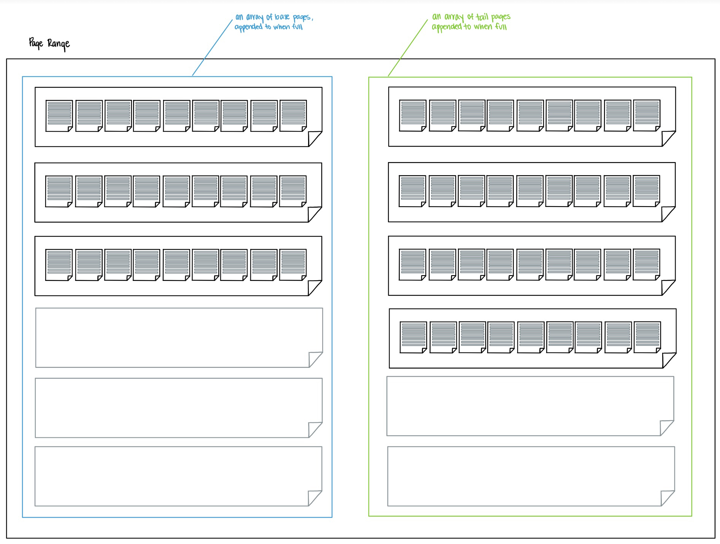
class PageRange:
def __init__(self):
self.basePages = []
self.tailPages = []
self.tailRID = -1
def baseInsert(self, RID, recordData)
def tailInsert(self, RID, fullRecord)
def update(self, baseRID, updatedRecord)
def getPreviousTailRecord(self, baseIndirectionRID)
def select(self, key, baseRID)
def delete(self, key, baseRID)
def invalidateTailRecords(self, indirectionRID, baseIndirectionRID)
def calculatePageIndex(self, RID)
def calculatePageOffset(self, RID)
def addPage(self, record)
def spliceRecord(self, oldRecord, updatedRecord)
Notes:
Determines page and physical location for a given query and uses Page.py functions to properly set up records and perform operations on them
steven

Slide 11
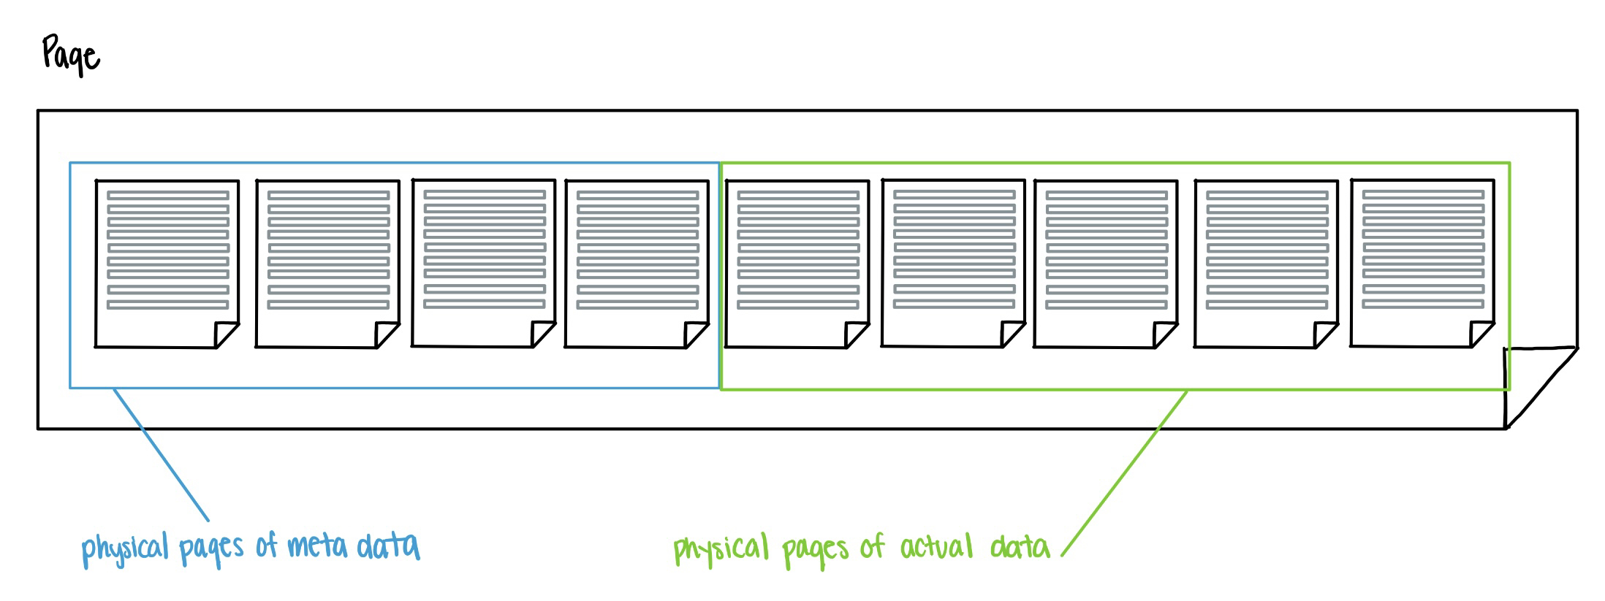
class Page:
def __init__(self, num_columns):
self.metaColumns = []
for i in range(0, MetaElements):
self.metaColumns.append(PhysicalPage())
self.dataColumns = []
for columns in range(0, num_columns):
self.dataColumns.append(PhysicalPage())
def baseInsert(self, RID, record)
def tailInsert(self, RID, record)
def getRecord(self, offset)
def newRecordAppended(self, RID, pageOffset)
def isFull(self)
def initializeRecordMetaData(self, baseRID)
def invalidateRecord(self, pageOffset)
Notes:
Andrew
Talk about cumulative updates maybe?

Slide 12
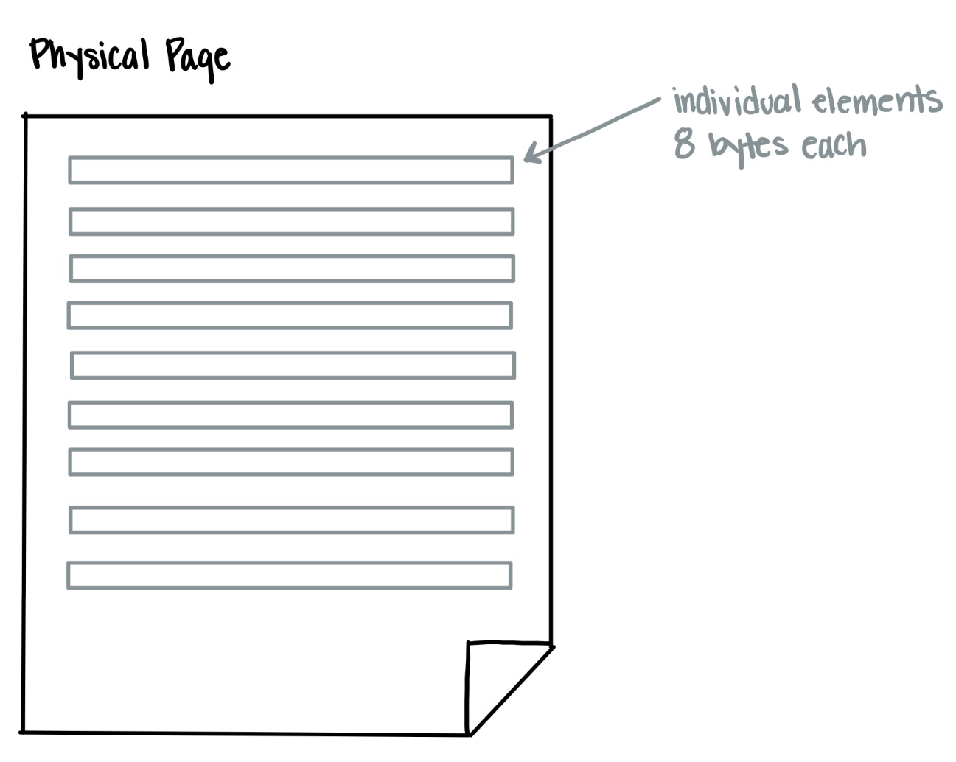
class PhysicalPage:
def __init__(self):
self.num_records = 0
self.data = bytearray()
def has_capacity(self)
def appendData(self, value)
def read(self, location)
def update(self, value, location)
Notes:
Stores data in a byte array and provides logic to append, read, and update data
nick

Slide 13
Milestone One
Nick Abcarius
Andrew Do
Travis Garcia
Nicole Pavlovich
Steven Tan

Slide 14
Next Steps:
Implement indexing and proper page directory
Look to further optimize our solution
Begin Milestone 2 requirements

